Slide 1

Generation of System Tests through Transition Systems
Final Results – Felix Hausberger

Slide 2
Agenda
Introduction to the Problem
Automatic Test Generation: A Use Case Driven Approach
An Automatic Approach to System Testing based on Scenarios and Operations Contracts
Synthesis
Conclusion
Introduction | Main Article | Research | Side Article | Conclusion | Questions

Slide 3
The Problem
Traceability problems between high-level use cases & concrete test case execution
Lack of integration of formal methods with well-established development life cycles
Shift effort of test generation to specification activity

Slide 4
Automatic Test Generation: A Use Case Driven Approach
Use cases and contracts
Simulation model (UCTS)
Interpreter
Simulator
Improving requirements via simulation and model checking
Requirements
Test objective generator (UCSystem)
Use cases scenarios
Test scenarios generator
(UC-SCSystem)
Test objectives
[1]
Manual phase
Set of test scenarios
Semi-automated phase
Automated phase
Notes:
Formalization of the requirements based on UML use cases enhanced with contracts (pre- & postconditions)
No ambiguities anymore
Made executable by writing them in the form of requirement-level logical expressions
Contracts used to infer the correct partial ordering of functionalities that the system should offer
Dedicated editor
Simulation model (Use Case Transition System)
Checks for correctness & consistency
Build model of all valid sequences of use cases
Extract relevant paths / „test objectives“ with coverage criteria
Generate test scenarios from test objectives
Replace each use case with a sequence diagram (use case scenario) that is compatible in terms of static contract matching using UC-SCSystem
Specify the exchange of messages involved between the environment and the system
Evaluation by using statement coverage
Tested at Thalès Airbourne Systems (TAS)

Slide 5
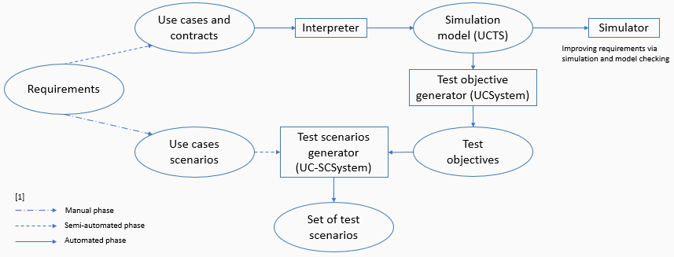
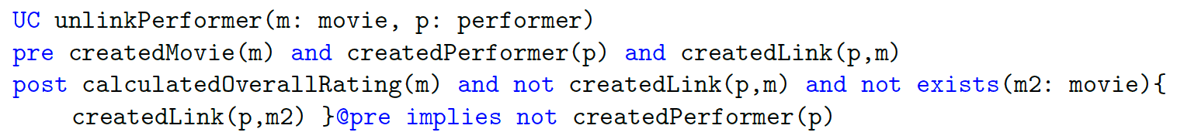
Automatic Test Generation: A Use Case Driven Approach
Phase I
Use cases ≈ “Main functions of the system”
Contracts: Specify system properties to make use cases applicable (preconditions) and system properties acquired by the system after the application of a use case (postconditions)
Notes:
Goal of this phase: generate test objectives
Contracts
Made executable by writing them in the form of requirement-level first-order logical expressions (predicates with logical expressions)
Used to describe facts in the system (on actors state, main concept states, roles, …)
Conditions always evaluate to true or false, never to undefined
Logical operators, quantifiers, implications
Parameters: actors and main concepts of the UC
Used to infer the correct partial ordering of functionalities that the system should offer
Limitations of the contracualized UC Model:
Deriving and maintaining a nonredundant, minimal set of contracts and predicates (Be precise and rigorous in the semantics given)
=>Editor tool to manage the predicates and guide the design of contracts
Handle complex data types
Deterministic postconditions

Slide 6
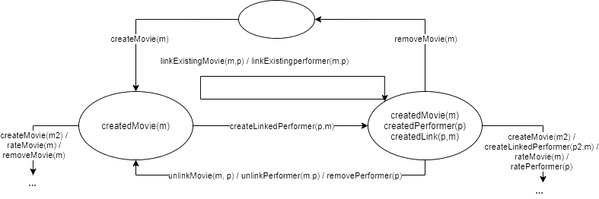
Automatic Test Generation: A Use Case Driven Approach
Phase I
UCSystem: Prototype/Interpreter-Tool
Builds the use case transition system UCTS (simulation model)
Generates correct sequences of use cases, i.e. “test objectives”
Notes:
Simulation phase: check & possibly correct the requirements before the tests are generated
=> Identify inconsistencies between predicates and contracts
=> Identify underspecification or errors in the requirements, verify invariants
Simulating the use cases:
Instantiated use cases: Replace set of formal parameters with all the possible combinations of their possible actual values (actors + main concepts)
Simulation state: set of instantiated predicates, that evaluate to true
Apply an instantiated use case: simulation state and precondition must match, update simulation state according to postcondition

Slide 7
Automatic Test Generation: A Use Case Driven Approach
Phase I
Generate test objectives from UCTS with regard to a given coverage criteria:
All Edges criterion (AE)
All Vertices criterion (AV)
All Instantiated Use Cases criterion (AIUC)
All Vertices and All Instantiated Use Cases criterion (AV-AIUC)
All Precondition Terms criterion (APT)
Robustness criterion
All algorithms are based on breadth-first search in the UCTS
Notes:
APT: all possible ways to apply a use case are exercised
Robustness criterion: exercise a use case in as many different ways as possible to make ist precondition false
Breadth-first search: obtain small test-objectives: human-understandable and meaningful

Slide 8
Automatic Test Generation: A Use Case Driven Approach
Phase II
UC-SCSystem:
Replace each use case of the test objectives by one of its use case scenarios
Generates test cases (JUnit) and runs them
Notes:
Goal of this phase: Generate test scenarios

Slide 9
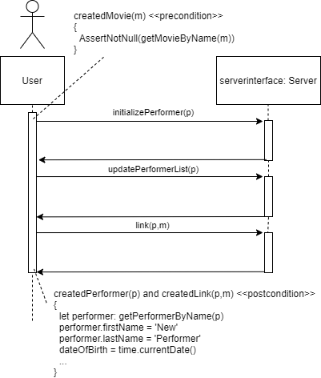
Automatic Test Generation: A Use Case Driven Approach
Phase II
Use case scenario contains the main messages exchanged between the tester and the SUT
Says how the system has to be simulated to perform a use case and how to react to the simulation
Contains more detailed pre- & postconditions
Contracts which rely on the rest of the model -> OCL
Contracts which rely on the predicates of UCs -> Formal language
Use case scenarios are system-level
Notes:
Use case scenario = Sequence diagram
Each use case scenario belongs to a use case: has the same parameters, either nominal or exceptional (functional vs. robust)
Each use case scenario => executable test case => test scenario (+ parameters & messages)
Attributes: instances the tester wants to deal with, to be completed by the tester
Each use case scenario has one method in the ScenarioPool (i.e. one test case)
Insert actual parameters to calls in the ScenarioPool
OCL contracts are transformed into JUnit assertions, the exchange of messages into Java calls

Slide 10
Automatic Test Generation: A Use Case Driven Approach
Challenges
Simulation model has to be compact enough to avoid combinatorial explosion of the internal states
maxsize_{UCTS} = 2^{Nip} with N_{ip} = p * (max_{instances})^{maxparam}
Two-phase approach (high-level vs. low-level requirements)
Use case parameters: main system concepts + actors
Test generation criteria
Automate the production of test objectives
Most efficient ones identified experimentally
Notes:
In practise many of the potential states are not reachable
Only a small number of instances are necessary for achieving statement coverage

Slide 11
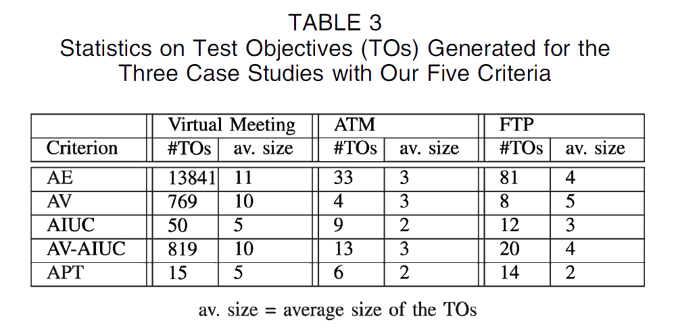
Automatic Test Generation: A Use Case Driven Approach
Evaluation
Notes:
All scenarios strategy: Every use case scenario has to be executed by at least one test case
Fail verdict: post condition violated
Pass verdict
Inconclusive verdict: precondition violated
Non-executed test scenarios
Because of underspecification or because of test data
Evaluation:
3 software programs (Automated Teller Machine, FTP Server and Virtual Meeting Server)

Slide 12
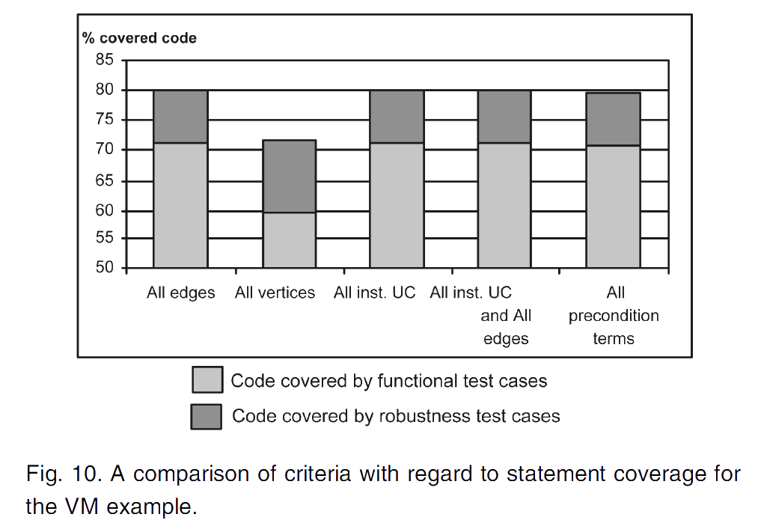
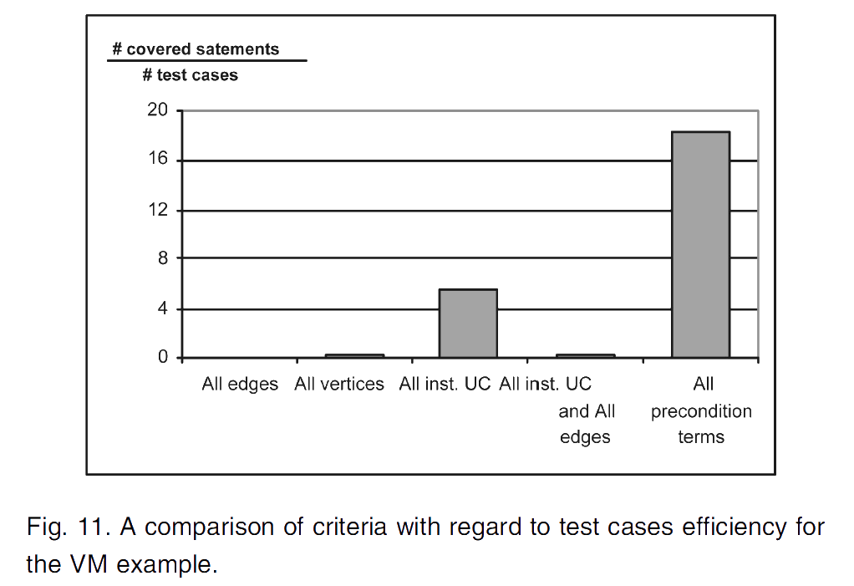
Automatic Test Generation: A Use Case Driven Approach
Evaluation
Notes:
Evaluation:
> 70% code coverage, with robustness > 80%
AV criterion low, because not all use cases covered (those, who do not change the system state)
Rest equal code coverage, but not in efficiency
AE, AV, AV-AIUC: low efficiency

Slide 13
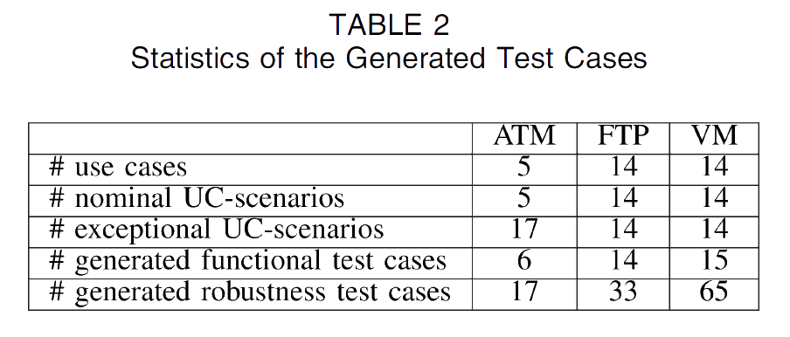
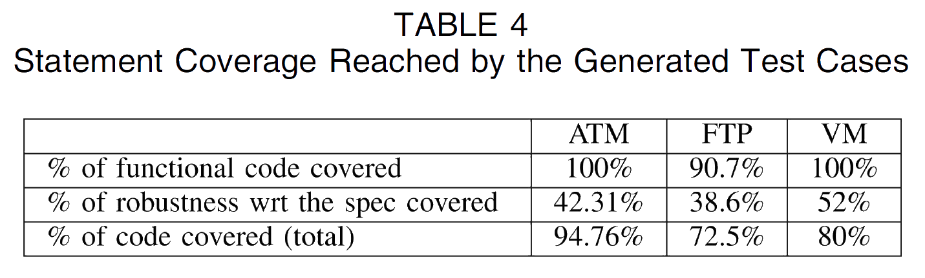
Automatic Test Generation: A Use Case Driven Approach
Evaluation
Notes:
Evaluation:
APT: 15 test cases -> 100% functional code coverage
Robustness criterion bad: high #TX -> Low efficiency (65 -> 52%)
Approach is good for functional code, bad for robustness code
Only violates preconditions of UCS
Take test data more into account
Violate preconditions of use case scenarios as well
Extension: Activity diagrams to model use case dependencies, not contracts!

Slide 14
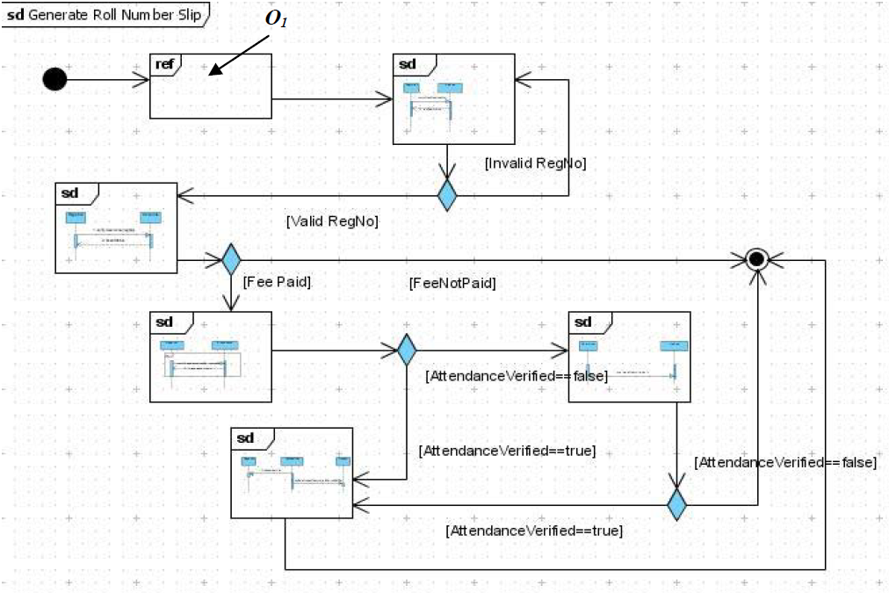
An Automated Approach to System Testing based on Scenarios and Operations Contracts
Uses scenarios expressed as UML Interaction Overview Diagram (IOD)
[2]
Introduction | Main Article | Research | Side Article | Conclusion | Questions
Introduction | Main Article | Research | Side Article | Questions

Slide 15
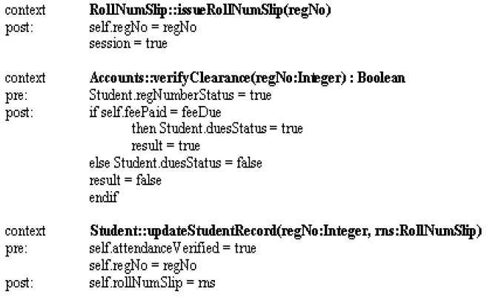
An Automated Approach to System Testing based on Scenarios and Operations Contracts
Contract Transition System (CTS) is built by enhancing the operations in the IOD with contracts written in Object Constraint Language (OCL)
[2]
Introduction | Main Article | Research | Side Article | Conclusion | Questions

Slide 16
An Automated Approach to System Testing based on Scenarios and Operations Contracts
Test paths are derived by path traversals from the inital node to the final node and by taking into account a specific coverage criterion
Transition coverage
State coverage
Transition pair coverage
The original paper differs as the transition system is generated on system level and not on a concrete scenario level
Introduction | Main Article | Research | Side Article | Conclusion | Questions

Slide 17
Conclusion
Both papers address the traceability problems between high-level views and concrete test case execution
Using only means of the specification level (use cases, use case scenarios and UML Interaction Overview Diagrams) one can automatically generate test cases using a transition system
Contracts are used to infer the correct partial ordering of functionalities that the system should offer
Coverage criteria define the amount of test cases to be generated
Introduction | Main Article | Research | Side Article | Conclusion | Questions

Slide 18
Generation of system tests through transition systems
Thank you for your attention

Slide 19

Questions
Introduction | Main Article | Research | Side Article | Conclusion | Questions
Introduction | Main Article | Research | Side Article | Questions

Slide 20
Sources
[1] Clémentine Nebut, Franck Fleurey, Yves Le Traon, Jean-Marc Jézéquel, Automatic Test Generation: A Use Case Driven Approach, 2006. [Online]. Available: https://ieeexplore.ieee.org/document/1610607 (visited on 11/25/2020)
[2] Najla Raza, Aamer Nadeem, Muhammad Zohaib Z. Iqbal, An Automated Approach to System testing based on Scenarios and Operations Contracts, 2007. [Online]. Available: https://ieeexplore.ieee.org/document/4385504 (visited on 11/25/2020)

